Slide 2
Analogy with Web Applications
When /^I create a movie $/ do
visit movies_path
click_link "Add Movie"
fill_in "Title" , :with => "Caddyshack"
select "1980" , :from => "Release Year"
check "Comedy"
click_button "Save"
End
When /^Phone A calls Phone B$/ do
@result = @res.eval (“oPhone$Orig makeCall -digits 2000 –noAnswer”)
End
Webrat is a Ruby Acceptance Testing for Web Applications that understand these calls
Glue code that needs to be developed. Ruby calling Tcl
Notes:
Here is an example of a step definition for a web application. In Cucumber, we create step such as “I create a movie”. This step is then translated on a sequence of actions including keywords such as “click_link” and “click_button” that are typical in web applications.
In our case, we could have something such as PhoneA calls PhoneB. This could be translated into a Modena call that makes this action. This is the glue code that needs to be developed.

Slide 3
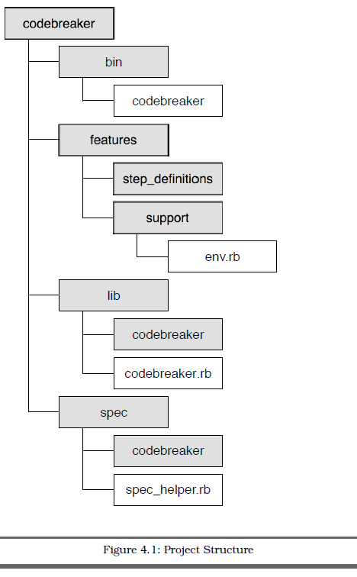
Project Structure
Contains executable scripts and/or binary files
Plain text description of features (.feature files)
Glue that ties plain text scenarios to app. code
Application code
Documentation and automation of RSpec code examples
Notes:
Let’s take a look at the project structure of a project using Cucumber.
bin contains any executable scripts and/or binary files.
features contains files related to documenting and automating Cucumber
features. This is where we already put our plain text feature
files.
The features/step_definitions directory will hold the step definition
files.
Step definitions are written in Ruby (.rb) files, and are the
glue that ties plain text scenarios in the feature files to the application
code.
The feature files should be in the features/ directory, each
with the .feature file extension. Cucumber recognizes this extension and
treats these files as input.
lib contains the application code.
spec contains files related to documenting and automating RSpec code
examples.

Slide 4
Behavior Driven Development (BDD)
Behavior-driven development is about implementing an application by describing its behavior from the perspective of its stakeholders.
Developer practice that involves writing tests before writing the code being tested.
Write only enough code to pass the one failing example, and no more.
Avoids use of exhaustive up-front requirements gathering process. Instead it favors the creation of an interactive session with working software. Exploratory testing to weed out bugs and edge cases.
Developers write a specification that nails down a small aspect of behavior in a concise and executable form.
Notes:
Behavior-driven development is about implementing an application by describing its behavior from the perspective of its stakeholders. Requirements are written in plain English and are understood by all team members.
Developer practice that involves writing tests before writing the code being tested (Reframing of Test Driven Development).
Begin by writing a very small test for code that does not yet exist. Run the test and, naturally, it fails. Now write just enough code to make that test pass. No more.
It favors the creation of an interactive session with working software. Exploratory testing to weed out bugs and edge cases that we might not think of until we’re actually interacting with the software. What is important is that the investment we’ve made to get this far has been very, very small compared to an exhaustive up-front requirements gathering process. An interactive session with working software is worth a thousand meetings.
Developers write a specification that nails down a small aspect of behavior in a concise, unambiguous, and executable form.
Behavior Driven Development means you write specifications of what your code will have to do. You work in tiny increments... specifying one small aspect of behavior at a time, then implementing it. Note that the word used is Specification, not Verification.

Slide 5
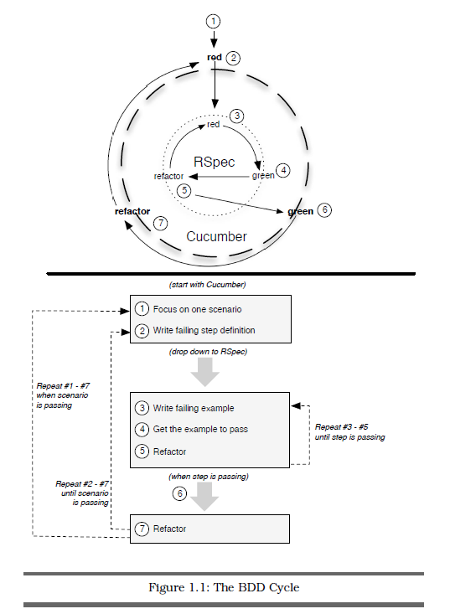
BDD Cycle
Process of driving out code
from the outside in, using Cucumber and RSpec together.
Notes:
This is the BDD cycle. Driving development from the Outside-In, starting with business facing scenarios in Cucumber and working our way inward to the underlying objects with RSpec.
The process is the Red-Green-Refactor cycle straight out of Test-Driven Development. The idea is that you write a failing example (red), write only enough code to make the example pass (green), and then remove any unwanted duplication (refactor).
Refactoring is the process of changing a software system in such a way that it does not alter the external behavior of the code yet improves its internal structure.
Once a developer have a failing step in a Cucumber scenario. This is the cue to jump from the outer circle (Cucumber) to the inner circle (RSpec) of the BDD cycle.

Slide 6
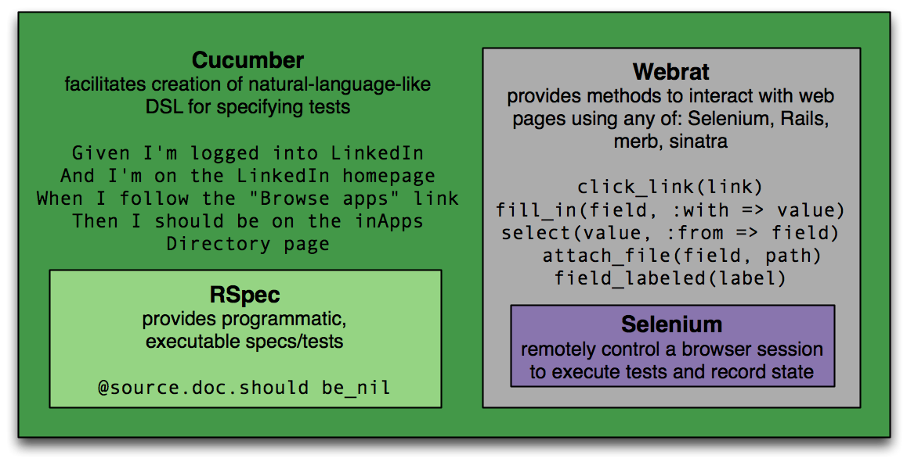
Other Tools
Notes:
Cucumber, based on RSpec, uses Webrat to drive Selenium.
Webrat stimulates the browser.
Watir and Selenium are in-browser testing tools.

Slide 7
Executable specifications
Can we move this idea further upstream, so that FFS can be executed?
Use cases could be written in such a way that they can be translated into automated scripts.
For example, these 3 documents are redundant in the use cases section:
FFS - EDCS-596000
Unit Test Plan - EDCS-710242
DevTest Plan: EDCS-677085

Slide 8
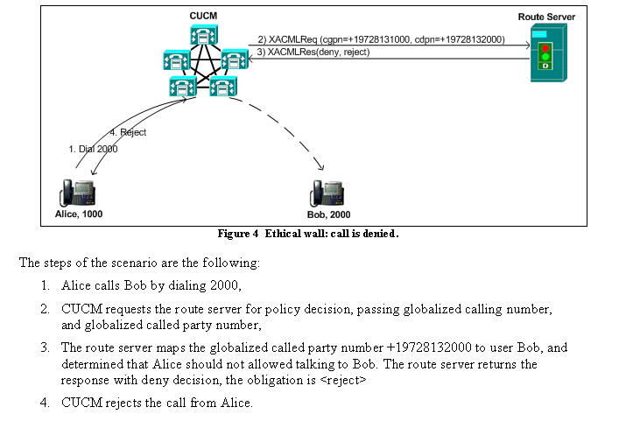
From ECC FFS - EDCS-596000

Slide 9
First step (By Bryan Gonderinger)
“template automation scripts” from test plan documents
Given test plan in Excel format (export to TIMS)
Generates template for all scripts
Generates job file
Generates suiteinfo.xml
Including Title, Description, Logical Identifier and step comments
http://bcomrtg/wiki/index.php/Automation_Autogen
Notes:
From: Bryan Gonderinger (bgonderi) Sent: Thursday, October 15, 2009 1:38 PM To: ipcbu-auto-stb(mailer list) Subject: Automation script autogeneration tool
I’ve put together a tool based on an initial idea by Alejandro Avella with refinements by Chris Thome that generates “template automation scripts” from test plan documents. Right now, it’s still pretty rough, but I think it is usable and would be helpful to someone responsible for writing new automation based on a test plan.
What it does is takes the Excel file that is generated when exporting the test plan to TIMS and uses it to generate a script file for each test case as well as a job file and suiteinfo.xml file. All of these files can be thought of as templates – they still need to be edited manually by the user, but this is still better than constructing them all from scratch (and will reduce the possibility of errors in this information as well).
The tool takes your test plan and uses various template files to generate the scripts and job files. The scripts contain the standard common setup, common cleanup and body sections, but have all the items like the test case title, description and logical IDs filled in from your test plan. The setup/cleanup/body sections also contain the entries from the procedures in your test plan as TCL comments – this allows you to edit the file and easily add the requisite Modena code to actually implement the test cases themselves. The job file contains some generic setup lines as well as the ats_run calls for all the generated scripts. The suiteinfo.xml file will contain all the testcase entries (logical IDs and titles), saving you a lot of work.
I put together a quick Wiki page that contains examples of the three file types at http://bcomrtg/wiki/index.php/Automation_Autogen (in the future, I’ll expand this page to include more information about the tool itself). In the meantime, if you or someone on your team would like to give this tool a try on your test plan, please get in touch with me.
Thanks,
Bryan

Slide 10
A medium complexity script
Scenario: Basic Call Coverage scenario
Given that prefix is “blank”
Given that digits are 2000
Given that forward type is Call Forward All
Given that forward destination is 7527
Given that Call Forward No Coverage 2001
Given that Hunt Pilot is 7527
Given that partition is pt-hq-internal
Given that Personal Preferences on the hunt pilot is checked for Hunt Forward No Answer
Given that Hunt Forward No Answer is blank
Given that Hunt Forward No Answer CSS is CSS_employee
Given that Personal Preferences on the hunt pilot is NOT checked for Hunt Forward Busy
Given the Hunt Forward Busy is blank

Slide 11
A medium complexity script (Cont.)
Given that Hunt Forward Busy CSS is CSS_employee
Given that Maximum Hunt Times is set to 60
Given COLP $ts_info(Phone$Dest,directoryNumber)
Given exCONPa $ts_info(Phone$Dest,alertingName)
Given exNumberDivA $ts_info(Phone$initDN,directoryNumber)
Given exNameDivA $ts_info(Phone$initDN,alertingName)
Given exNumberDivB $ts_info(Phone$M4,directoryNumber)
Given exNameDivB $ts_info(Phone$M4,alertingName)
Given exCLIP $ts_info(Phone$Orig,directoryNumber)
Given exCNIP $ts_info(Phone$Orig,displayName)
Given exCOLP_f $ts_info(Phone$Dest,directoryNumber)
Given exCONP_f $ts_info(Phone$Dest,displayName)
Given exCLIP_f $ts_info(Phone$Orig,directoryNumber)
Given exCNIP_f $ts_info(Phone$Orig,displayName)

Slide 12
A medium complexity script (Cont.)
Given that Hunt Pilot 7527 with settings specified above
Given Set Called DN Call Forward type to a Hunt Pilot
Given Set Call Coverage settings for DN
Given Initialize 16 phones
When Make B Busy, if a CFB test case
When A calls B, but B is CFA to Hunt Pilot
Then first line group member rings
Then first line group member stops ringing
Then second line group member rings
Then second line group member stops ringing
Then third line group member rings
Then third line group member stops ringing
Then fourth line group member rings
Then fourth line group member stops ringing
Then after hunting, final forward destination rings as specified in the givens above.
Then phone displays are correct while ringing
Then phone displays are correct after answering
When Phone B ends call
When if phone B busy, end call
Given clear Hunt Pilot settings
Given clear Call Forward settings
Given clear Call Coverage settings

